Slide 1
Battle For Avengers

Slide 2
Developed By: Mahfuzur Rahman Emon Registration No. : 2017831003 Dept. of Software Engineering.
Institute of Information and Communication
Shahjalal University of Science and Technology , Sylhet .

Slide 3
Introduction
This is a space-shoot type game. You have to cross 3 different stage to complete this game. You will use arrow keys for changing your spaceship’s location and ‘Space’ button to fire bullet . There is no score board on this game. This is a kind of mission based game.
Best of Luck !

Slide 4
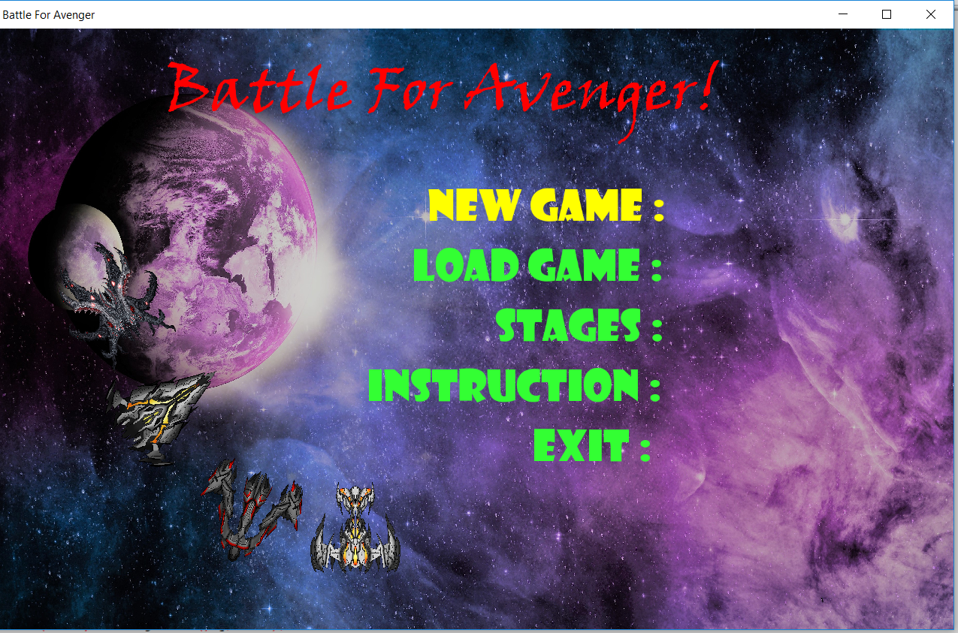
Menu Bar

Slide 5
Menu Bar
In the Menu Bar, there are 5 option. 1. New Game : Which is used to restart the game from the begining.
2.Load Game : This option is used to restart the game from where it was stopped. 3.Stage : It is used to select the stage. There are 3 stages. You can select any stage that you want. But , if you don’t select any stage, then the game will be in first stage by default. 4.Instruction : There are some basic instruction to play this game in this option. 5.Exit : To get out from the game, this option is used.

Slide 6
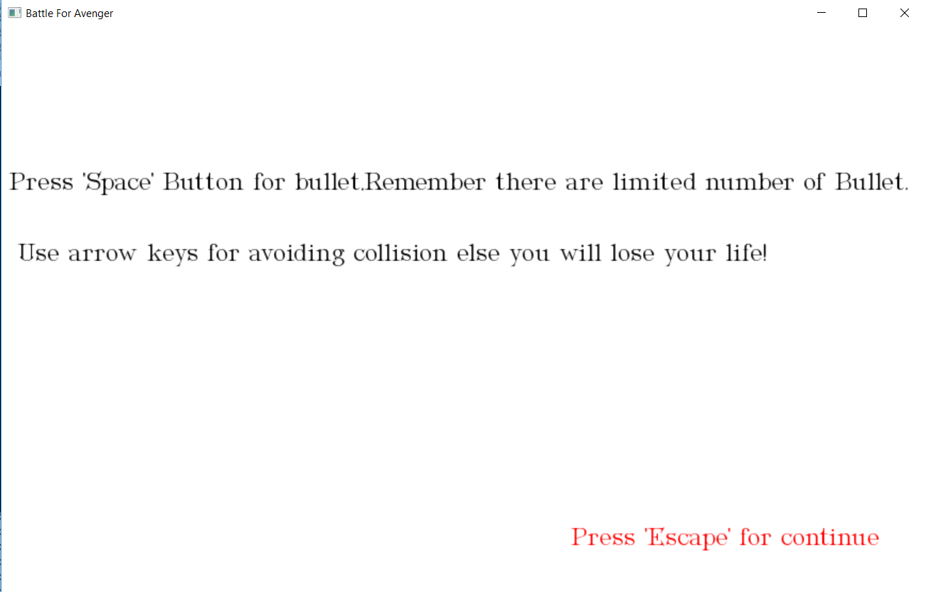
Instruction
By selecting Instruction option from Menu Bar, you will find this page

Slide 7
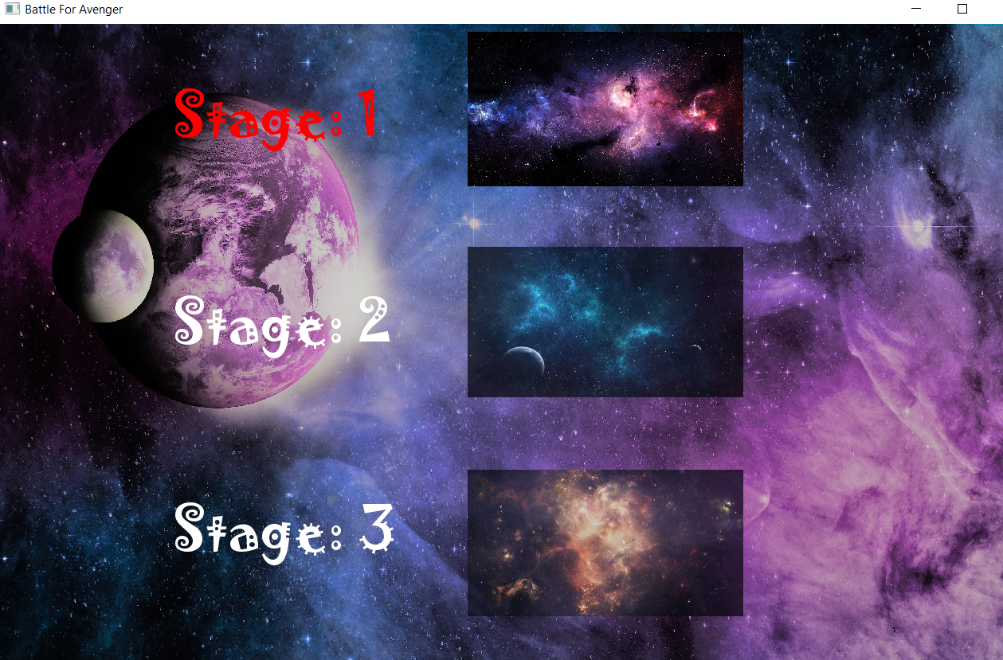
Stages

Slide 8
Stages
By selecting ‘Stage’ option from the Menu we can see that , there are 3 stages in this option. We can select the stage that we want to play by pressing ‘Enter’.

Slide 9
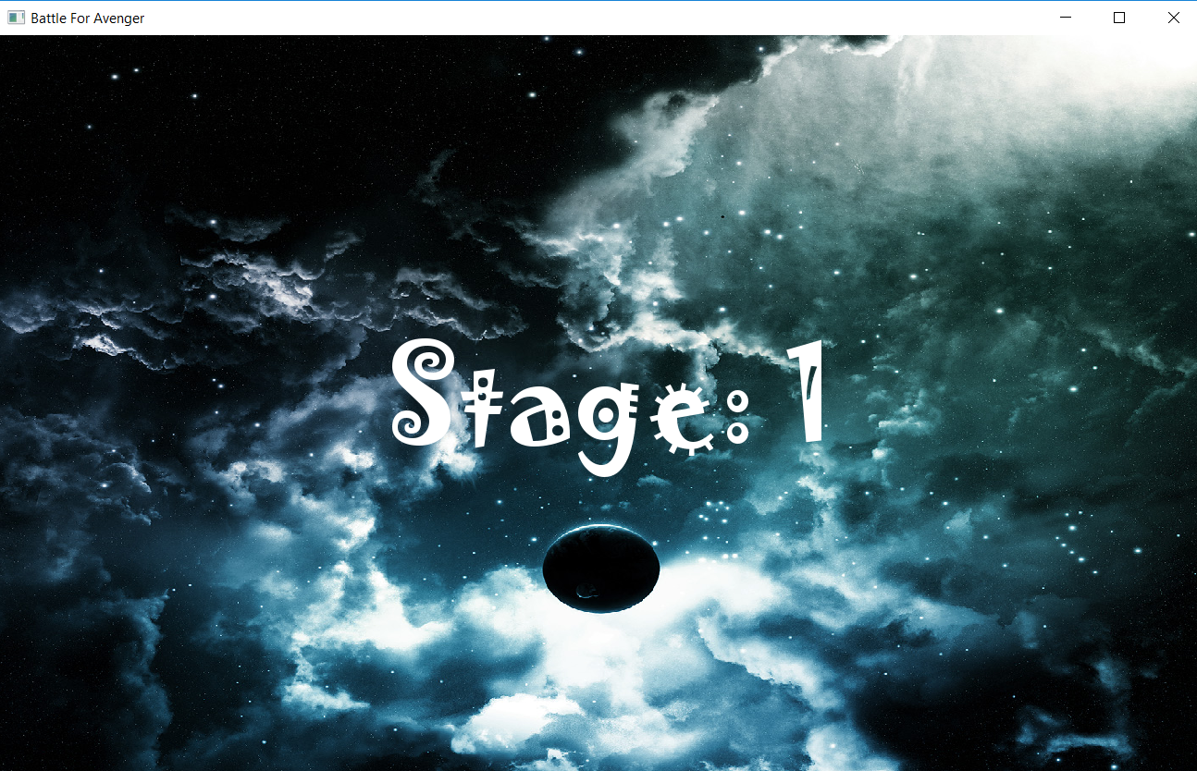
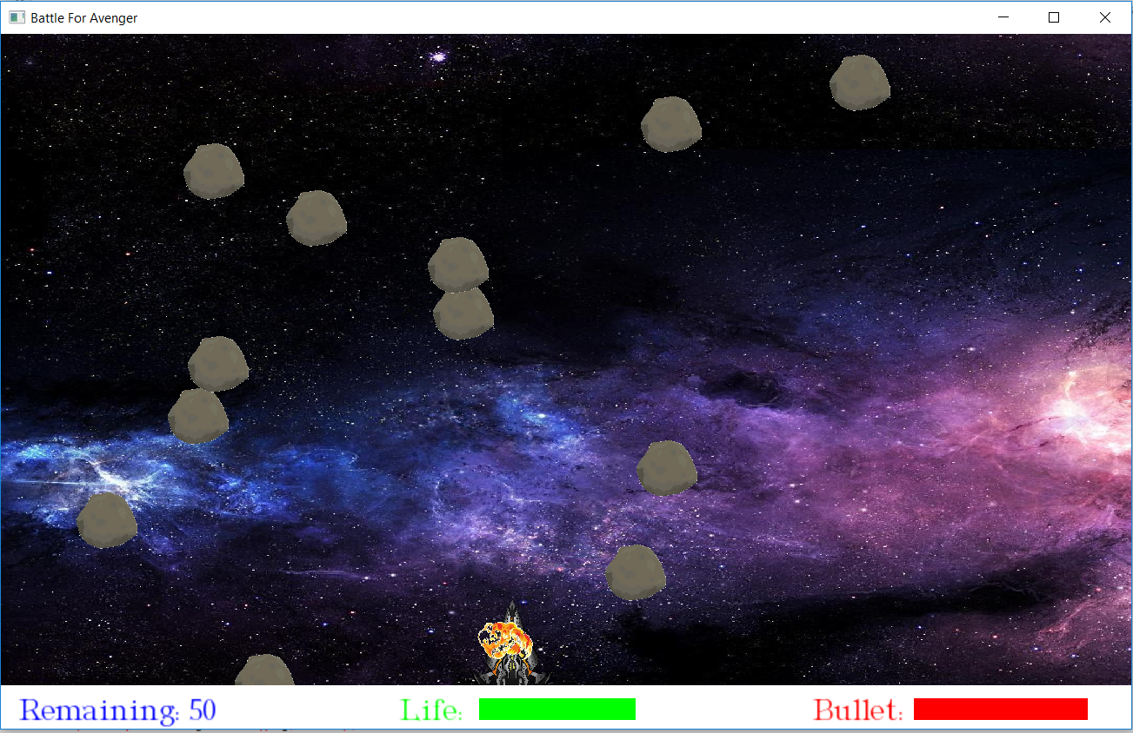
Stage 1

Slide 10
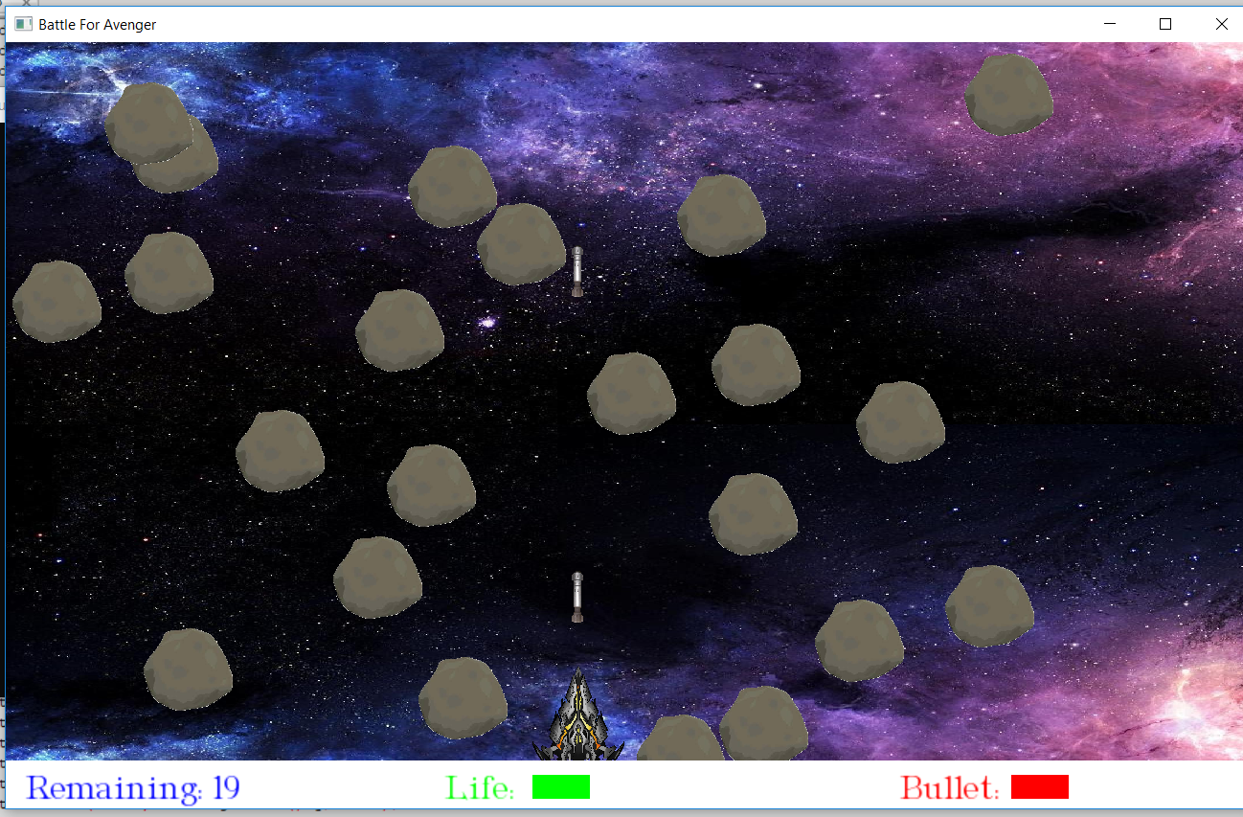
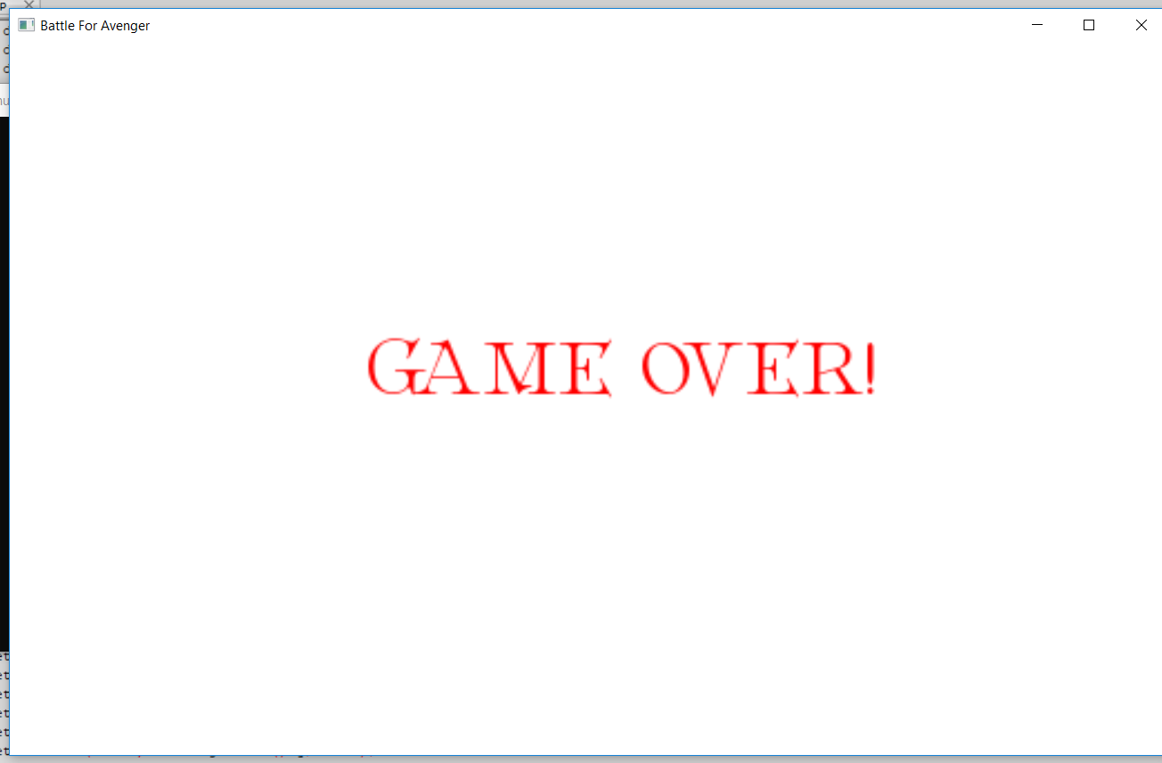
Stage 1

Slide 11
Stage 1
In this stage, the spaceship need to go ahead by clearing the obstacles. The spaceship can intersect with obstacles for tenth(10) time maximum. The spaceship have to destroy fifty(50) obstacles to complete this stage. In this stage the spaceship can use maximum hundred(100) bullet . You can move your spaceship only horizontally. After destroying 25 obstacles, the speed of the spaceship will be increased, and the size of the obstacles will be larger too. If spaceship intersect with obstacles more then tenth time, the game will be over. If spaceship can’t destroy 50 obstacles with his limited number(100) of bullets, the game will be over.
If spaceship can destroy 50 obstacles, the game will be promoted into stage 2.

Slide 12
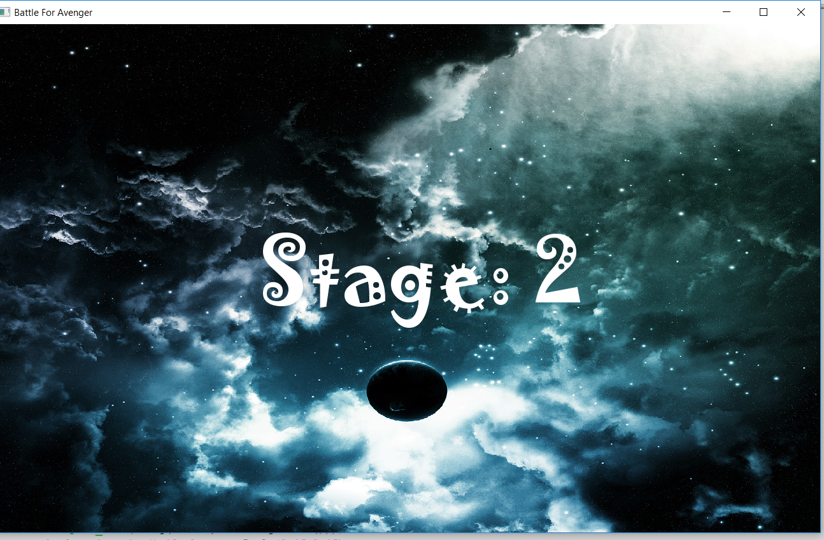
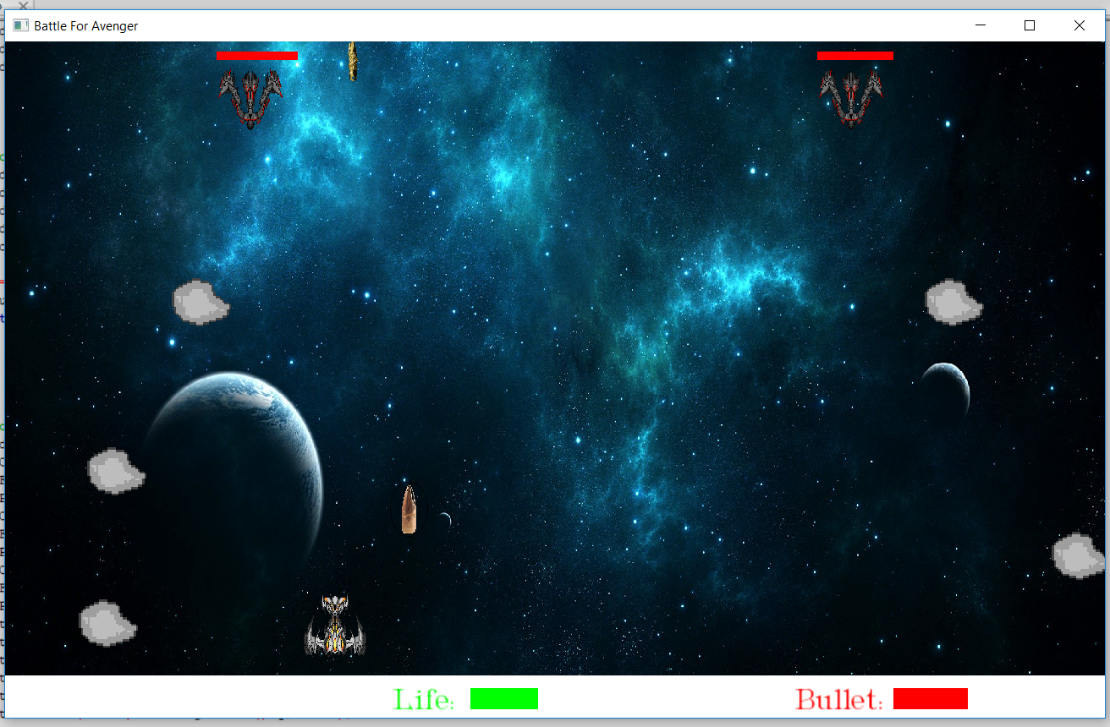
Stage 2

Slide 13
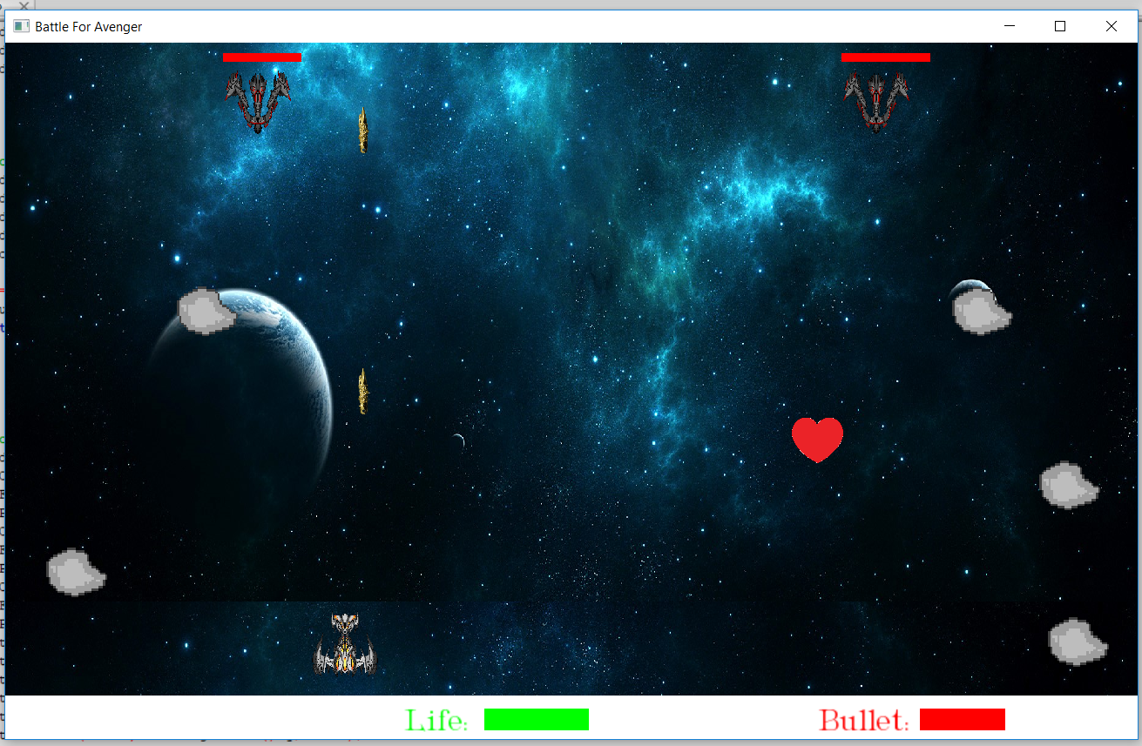
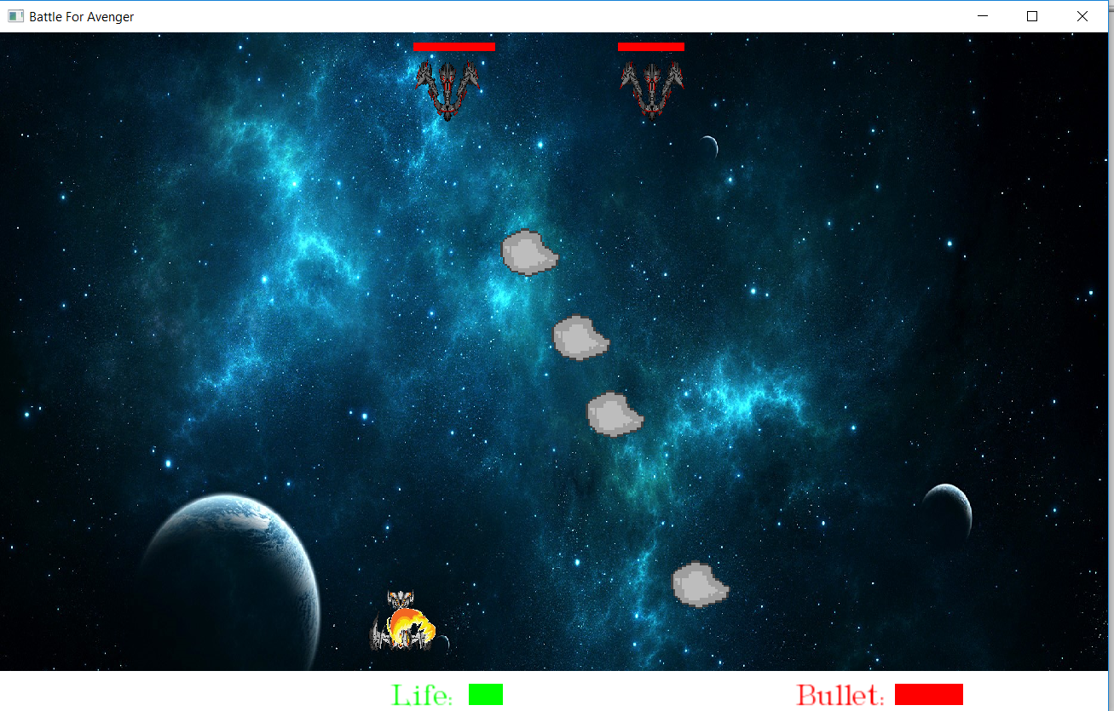
Stage 2

Slide 14
Stage 2
There will be 2 enemy ship in this stages. They will continue throw bomb to your spaceship. To vanish them you have to shoot each of them for 20 times. If the bombs intersects with your spaceship , your spaceship’s life will be decrease .You will get bonus life packet and bonus bullet packet after certain time interval . You have to collect them for healing your life , and getting extra bullet . You can move your spaceship both vertically and horizontally .
If your life become zero, then the game will be over.
If you can destroy both spaceships of oponents, you will be promoted into Stage 3.

Slide 15
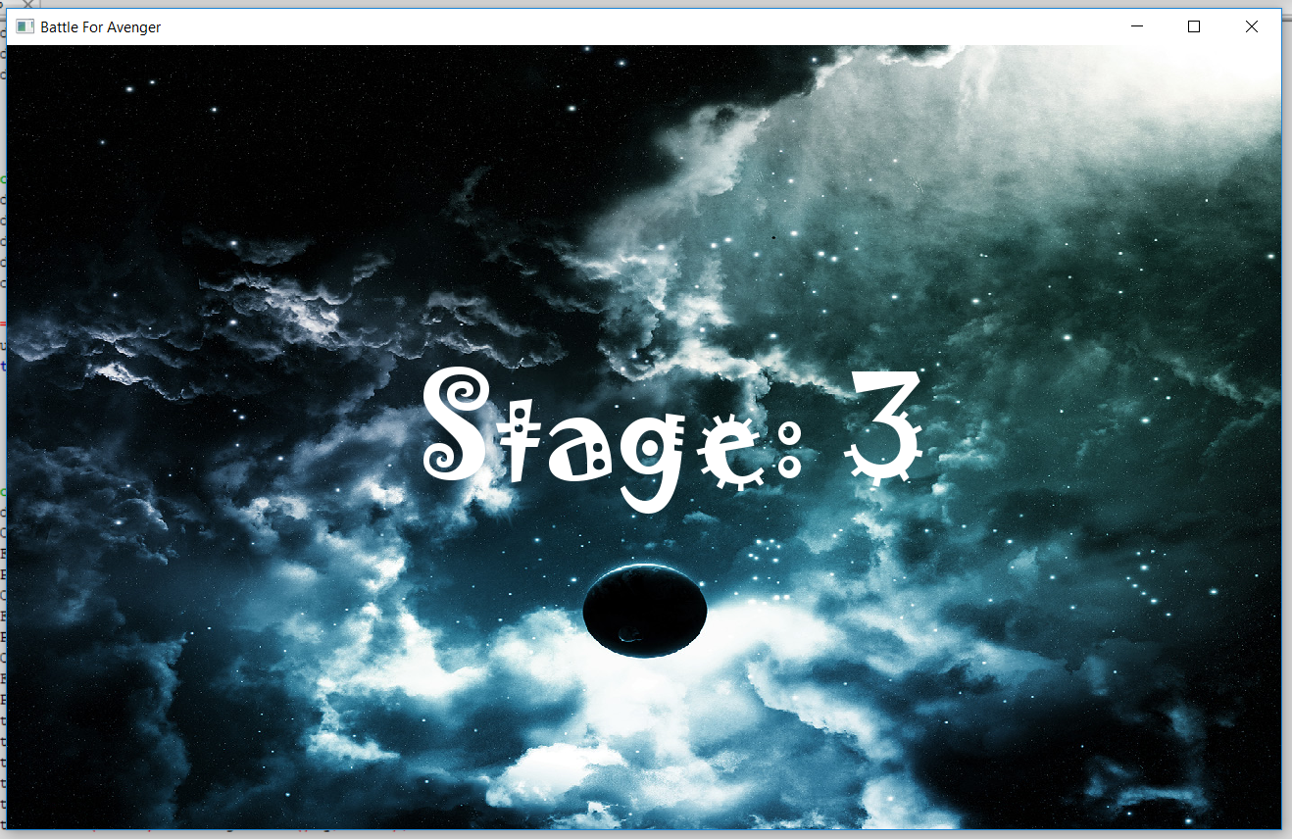
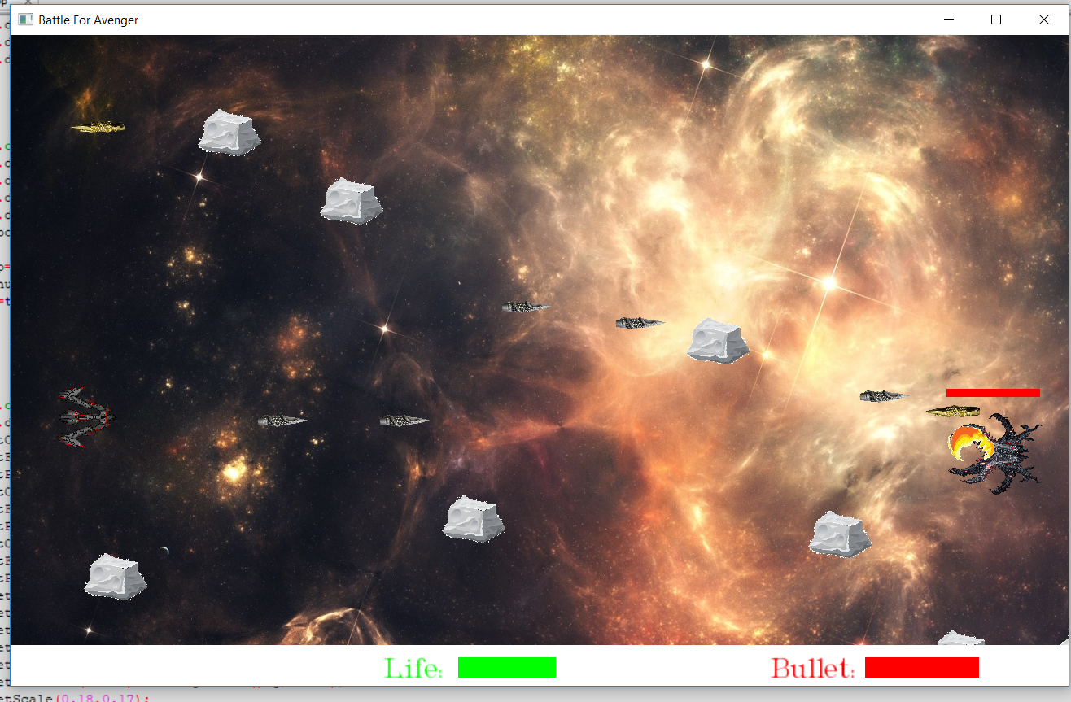
Stage 3

Slide 16
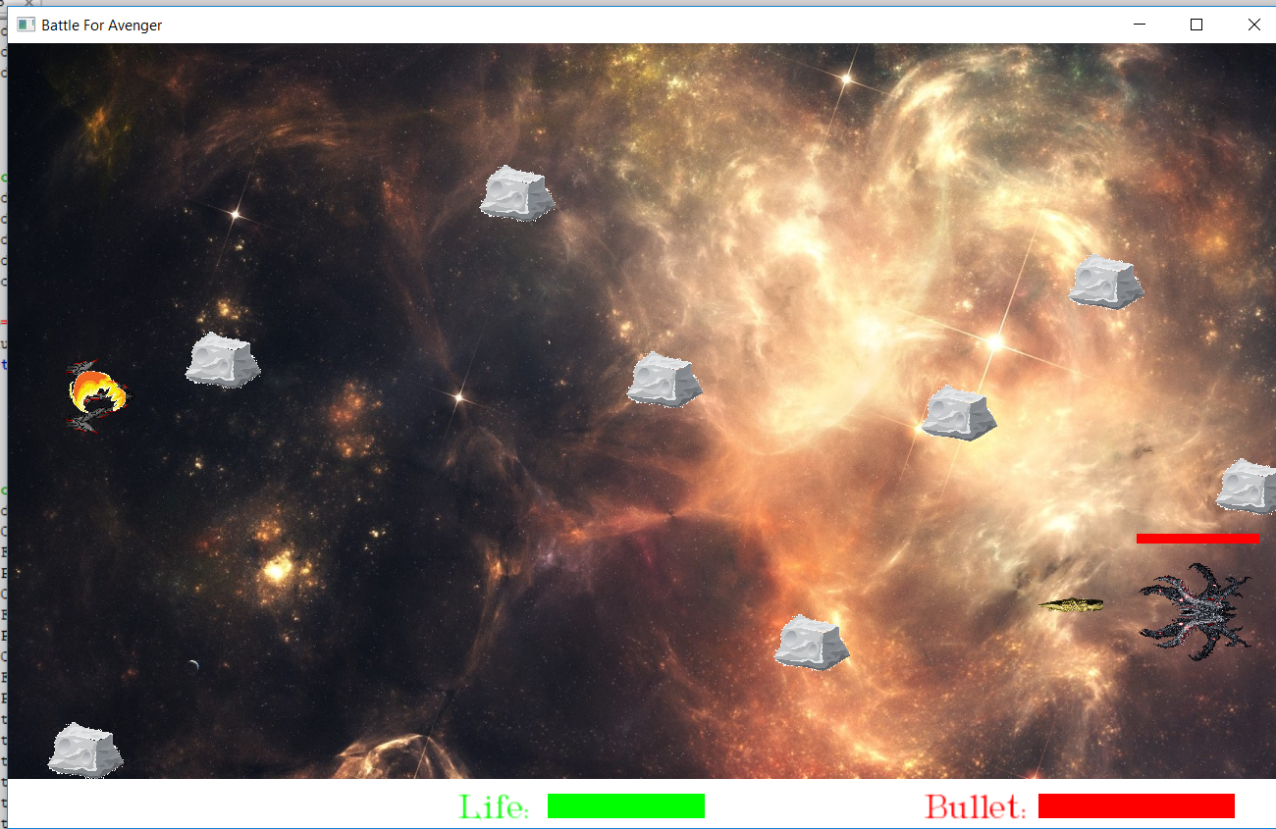
Stage 3

Slide 17
Stage 3
In this Stage, there will be a space ship of opponent’s boss which will fire you continuously. You have to get rid of those fire, otherwise your life will be decreased. In this stage their will be obstacles too, which will try to destroy you. You have to become safe from them .You can move your spaceship both vertically and horizontally . You will get limited number of bullets(100) and life. You will not get any healing pack or extra-bullet pack. You have to shoot boss’s space-ship for 30 time to vanish it. If you can destroy enemies ship, this game is over for you !

Slide 18
Thank You All.

